Slide 1


COMMUNIST PROGRAMMERS PARTY
START

Slide 2
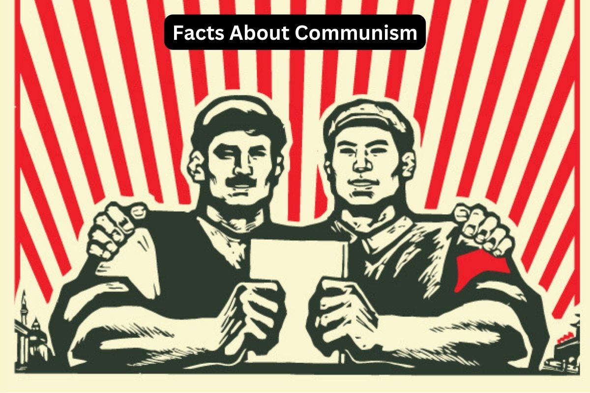

Slide 3
What is CPP?
2
Our company is composed of communist programmers that aims to give all its members a fair share much like a communist ran country.

Slide 4
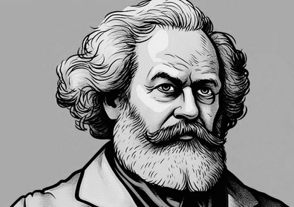
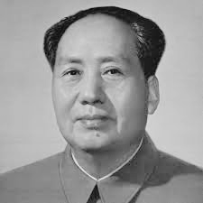
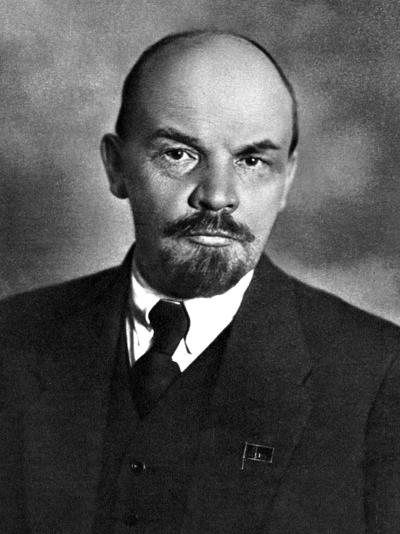
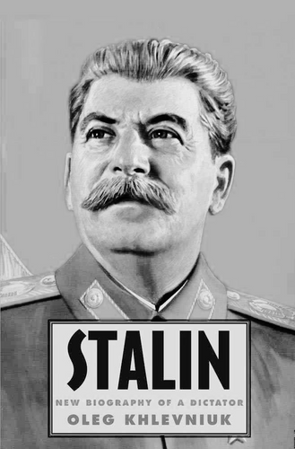
MEMBERS
Atim
David
Velasquez
Dizon

Slide 5
1
Project:
Digitalization

Slide 6

In a world ravaged by an apocalyptic catastrophe, "Digitalization" thrusts you into the heart of a desolate future where survival is a daily struggle and every decision could mean the difference between life and death. The game’s action-packed narrative unfolds in a sprawling wasteland, a stark landscape of crumbling cities, treacherous ruins, and uncharted territories teeming with danger.

Slide 7
2
Inspiration
MARIO & LUIGI
OCTOPATH TRAVELER
DARK SOULS
HADES

Slide 8
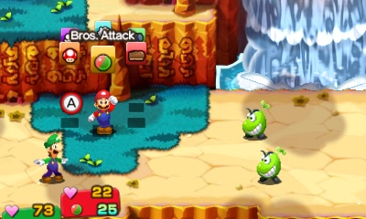

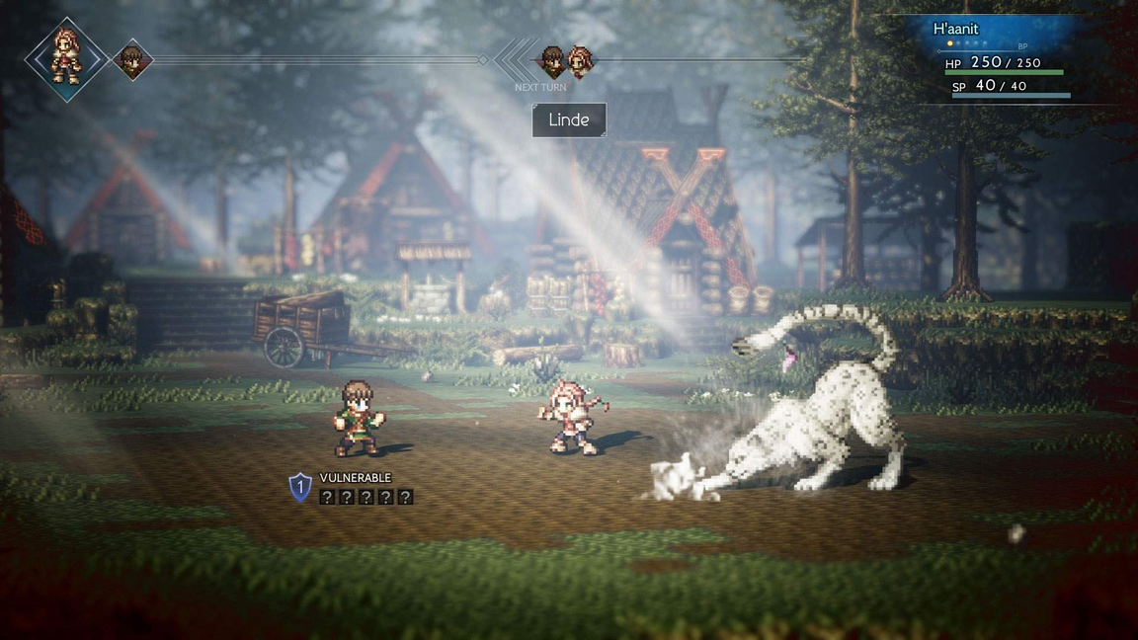
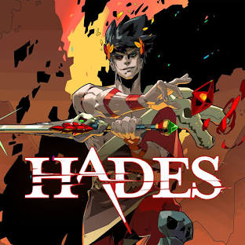

Slide 9
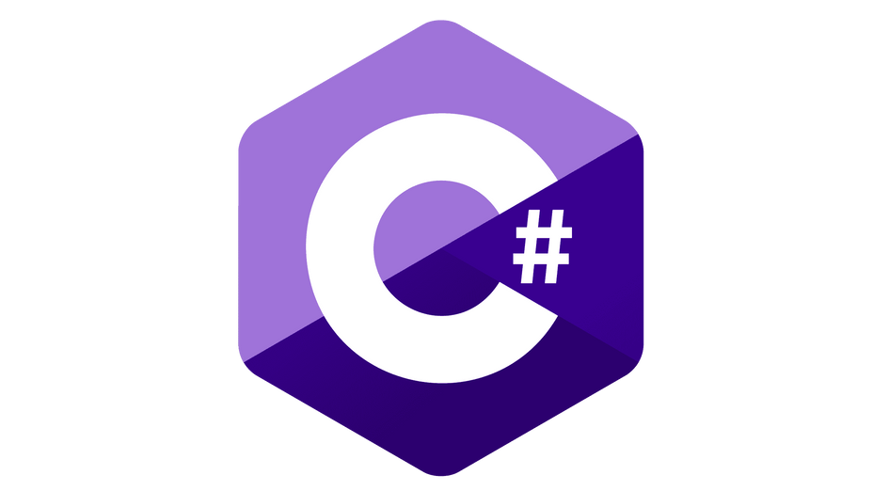

Skills Needed

Slide 10

Additional Tools

Slide 11

SCRUM

Slide 12
Scrum Framework
The Scrum framework is a popular agile methodology used for managing complex projects.

Slide 13
It begins with creating and refining a prioritized product backlog, followed by sprint planning where the team selects backlog items to work on. During the sprint, team members collaborate daily in standup meetings and complete development tasks. At the end of each sprint, a review meeting is held to demonstrate the completed work and gather feedback, followed by a retrospective to reflect on the process and identify improvements. This cycle ensures continuous delivery of valuable increments, with ongoing adjustments based on stakeholder feedback and team insights.

Slide 14



Slide 15
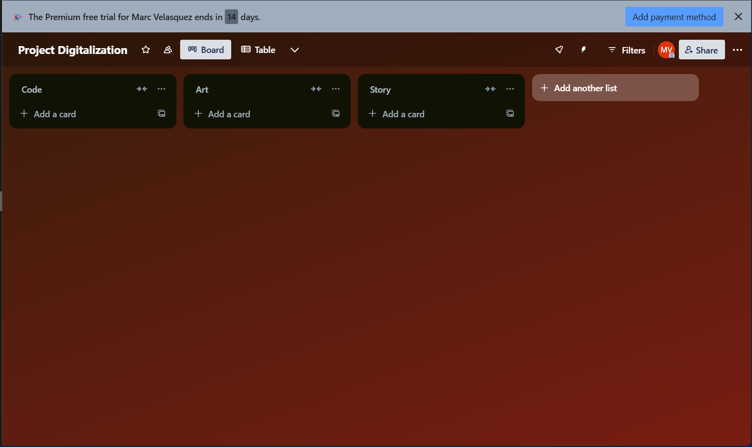

Slide 16
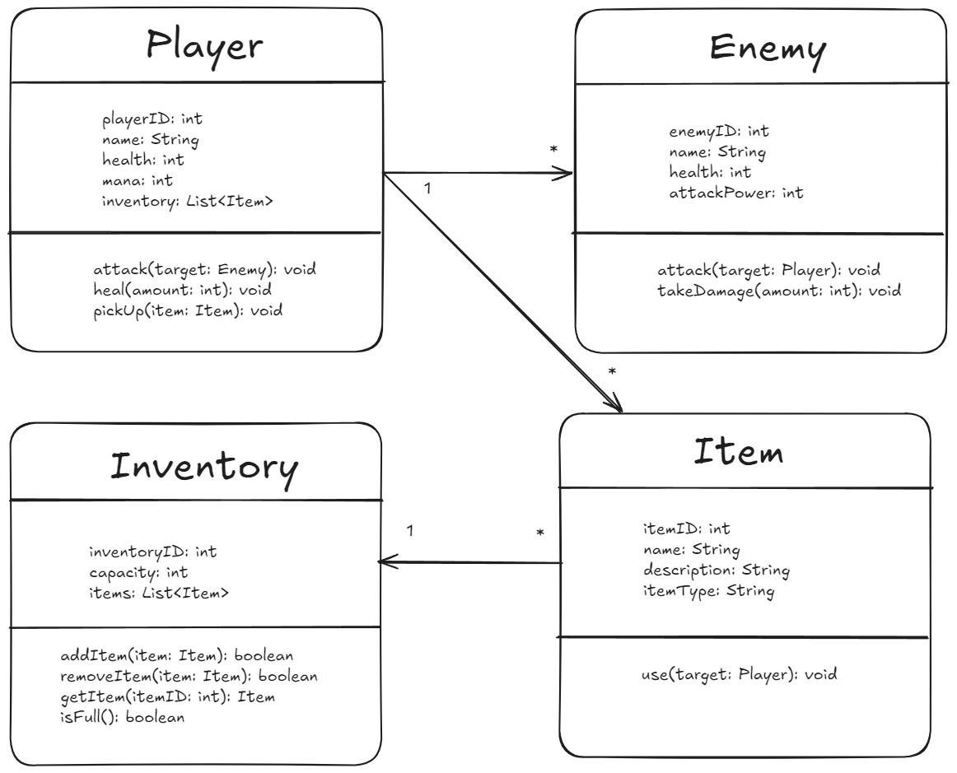
Class Diagram

Slide 17
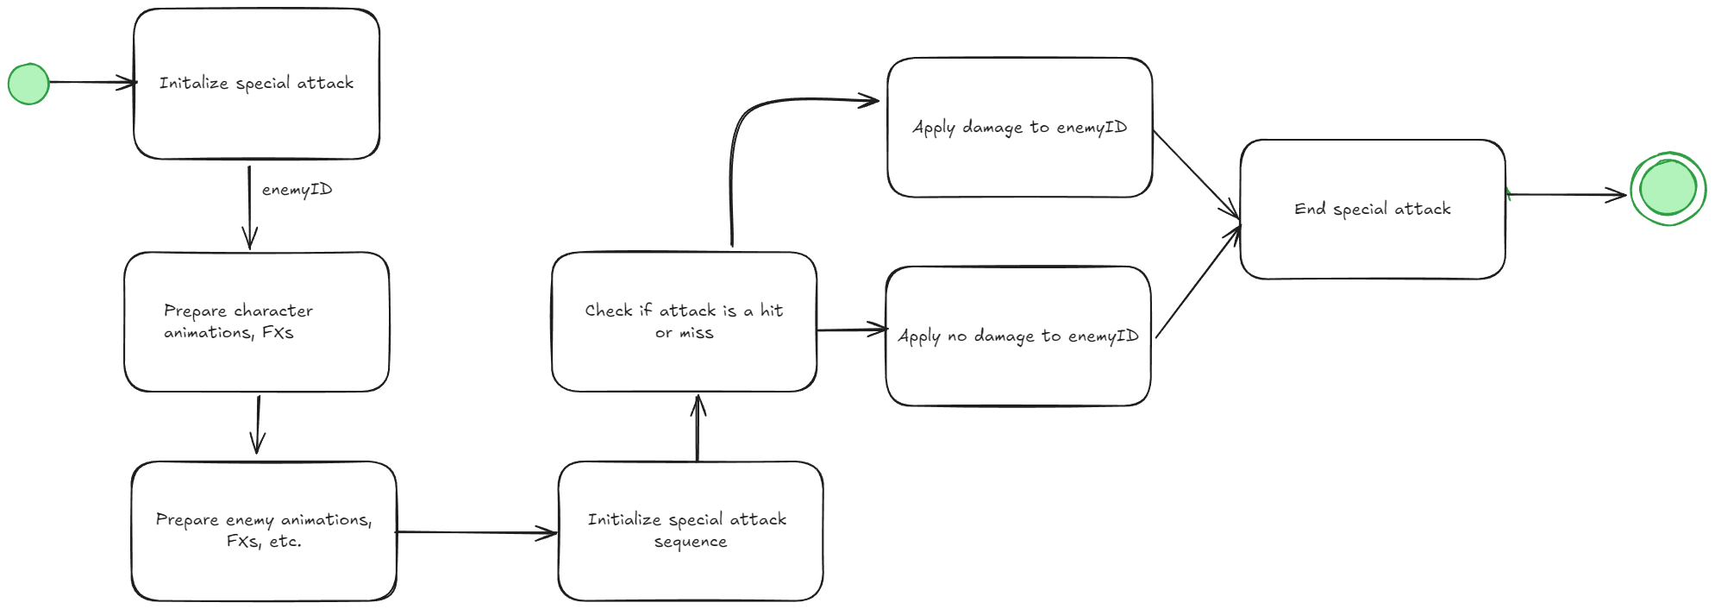
State Machine Diagram

Slide 18
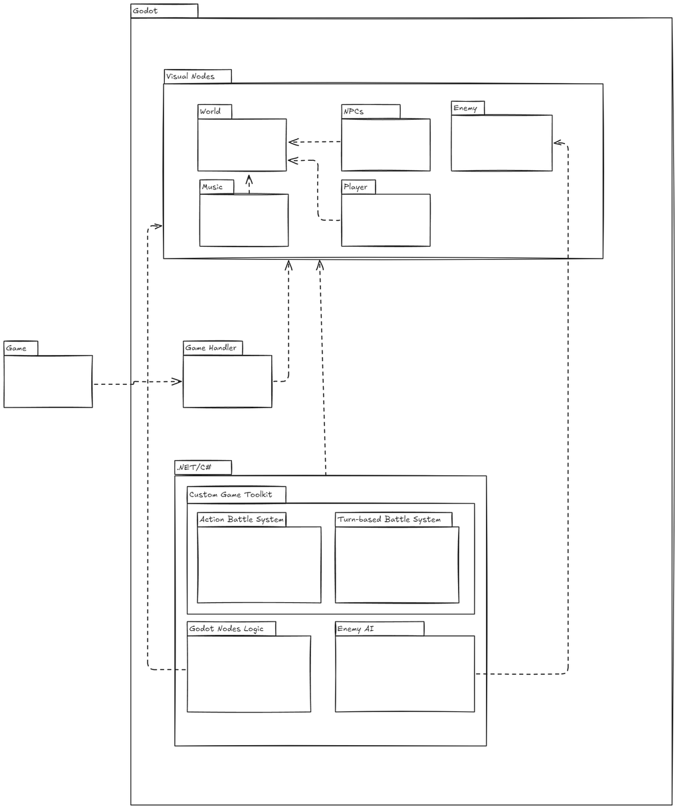
Package Diagram

Slide 19
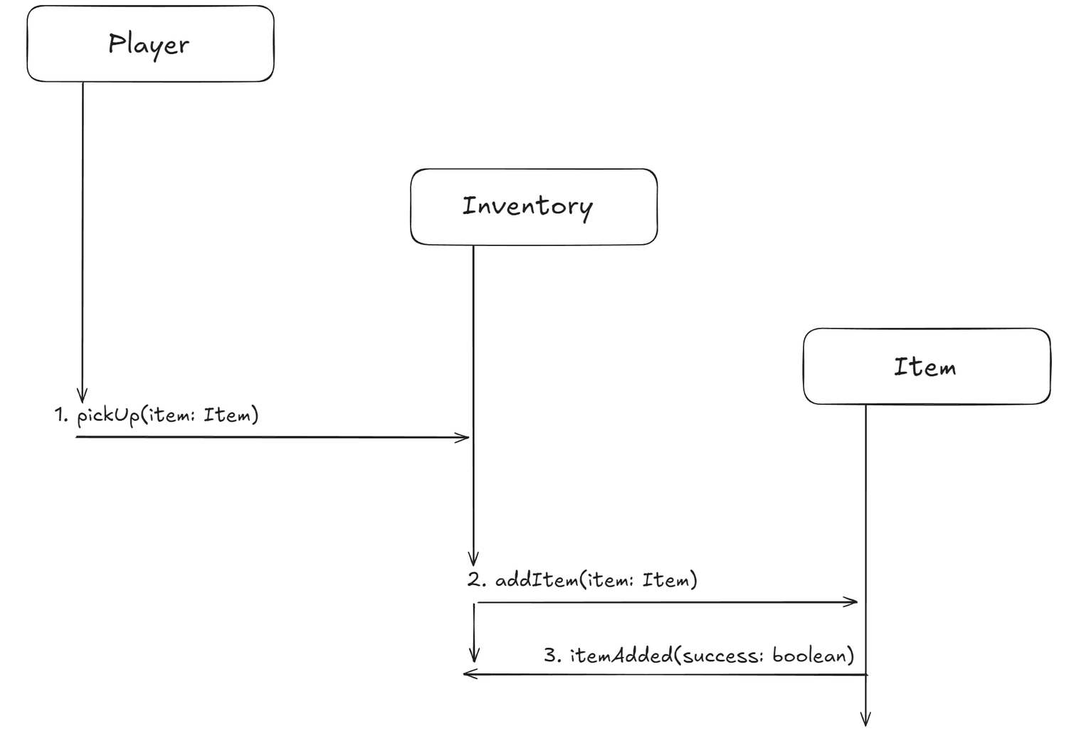
Communication Diagram

Slide 20
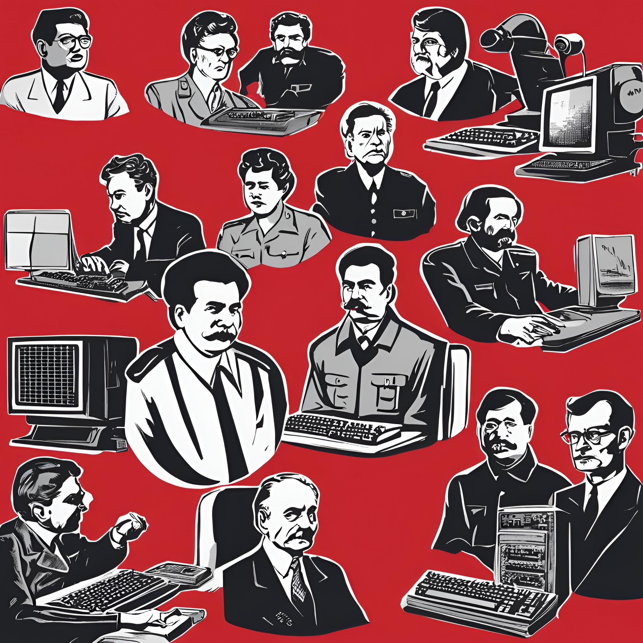

Thank You!

